Slide 1
Green University of Bangladesh
Department of Computer Science & Engineering
Subject: Statistics and Complex Variables
Course Code: MAT-201
My Presentation topic : Matrix
Submitted To:
Name : Tanzila Yeasmin Nilu
Designation : Lecturer
Department : CSE
Green university of Bangladesh
Submitted by:
Name : Nazifa Alam Nowrin
ID :193002103
Department : CSE

Slide 2
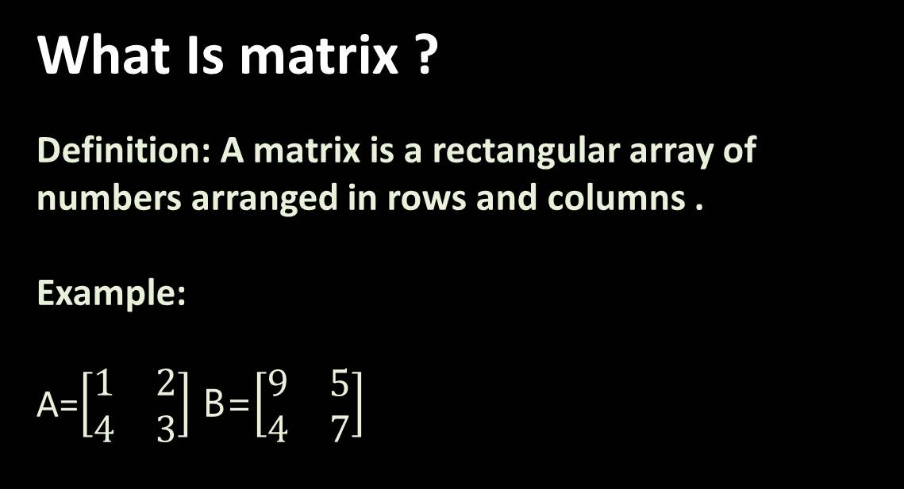
What Is matrix ?
Definition: A matrix is a rectangular array of numbers arranged in rows and columns .
Example:
A=$\left[\begin{matrix}1 & 2 \\ 4 & 3\end{matrix}\right]$ B=$\left[\begin{matrix}9 & 5 \\ 4 & 7\end{matrix}\right]$

Slide 3
Matrices are of many types such as:
Square matrix
Null matrix
Diagonal matrix
Identity matrix
Rectangular matrix
Scalar matrix
Inverse matrix
Transpose matrix
Symmetric matrix
Orthogonal matrix
Skew symmetric matrix

Slide 4
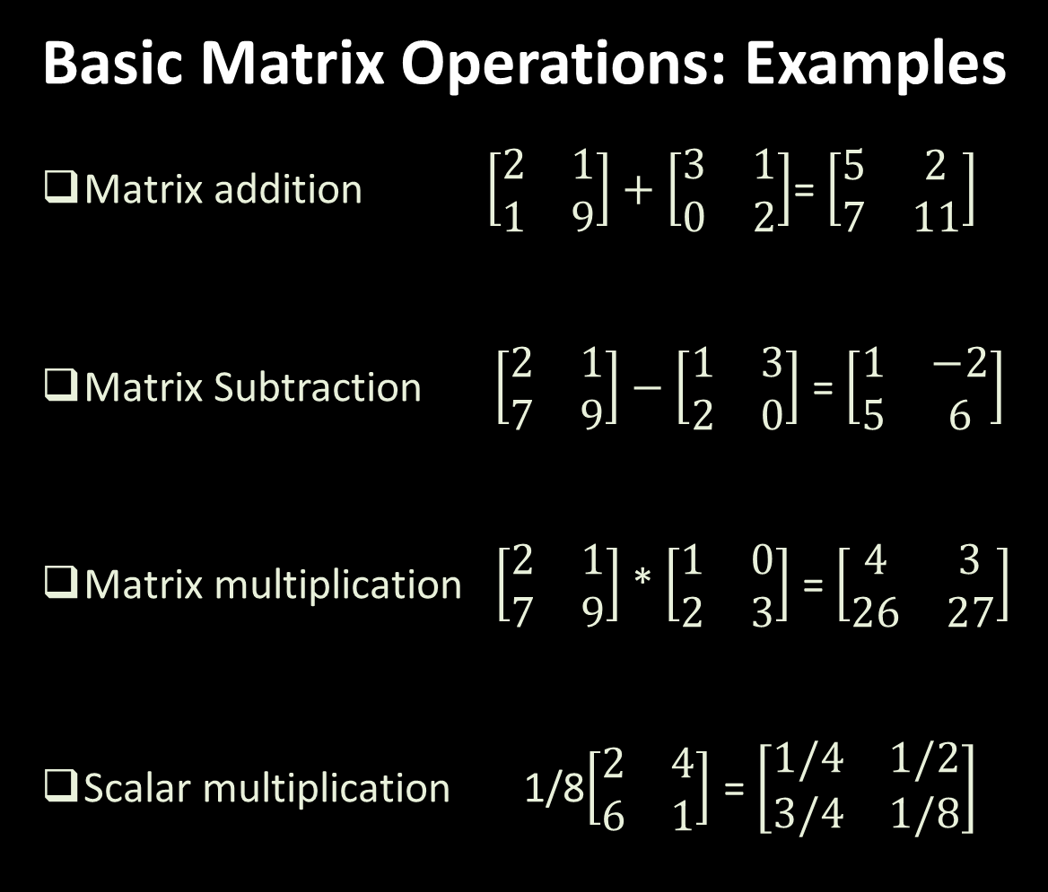
Basic Matrix Operations: Examples
Matrix addition $\left[\begin{matrix}2 & 1 \\ 1 & 9\end{matrix}\right]+\left[\begin{matrix}3 & 1 \\ 0 & 2\end{matrix}\right]$= $\left[\begin{matrix}5 & 2 \\ 7 & 11\end{matrix}\right]$
Matrix Subtraction $\left[\begin{matrix}2 & 1 \\ 7 & 9\end{matrix}\right]−$ $\left[\begin{matrix}1 & 3 \\ 2 & 0\end{matrix}\right]$ = $\left[\begin{matrix}1 & −2 \\ 5 & 6\end{matrix}\right]$
Matrix multiplication $\left[\begin{matrix}2 & 1 \\ 7 & 9\end{matrix}\right]$ * $\left[\begin{matrix}1 & 0 \\ 2 & 3\end{matrix}\right]$ = $\left[\begin{matrix}4 & 3 \\ 26 & 27\end{matrix}\right]$
Scalar multiplication 1/8$\left[\begin{matrix}2 & 4 \\ 6 & 1\end{matrix}\right]$ = $\left[\begin{matrix}1/4 & 1/2 \\ 3/4 & 1/8\end{matrix}\right]$

Slide 5
Application of matrices in real Life :
In geology matrices are used for taking seismic surveys
Solving the problem using kirchoff’s laws or voltage and current , the matrices are essential
Matrices is the best method for putting common survey things
Some properties of matrix mathematics are important in math theory
Cryptogram is one of the best application of matrices .

Slide 6
Thank you

